Slide 1
VT Updated Slides for PAAW Project
Rakesh K. Kapania
Mitchell Professor of Aerospace and Ocean Engineering
Wei Zhao
Rikin Gupta
Neeharika Muthirevula
March 19, 2015
Multidisciplinary Analysis and Design Center for Advanced Vehicles Virginia Polytechnic Institute and State University Blacksburg, VA 24061-0203

Slide 2
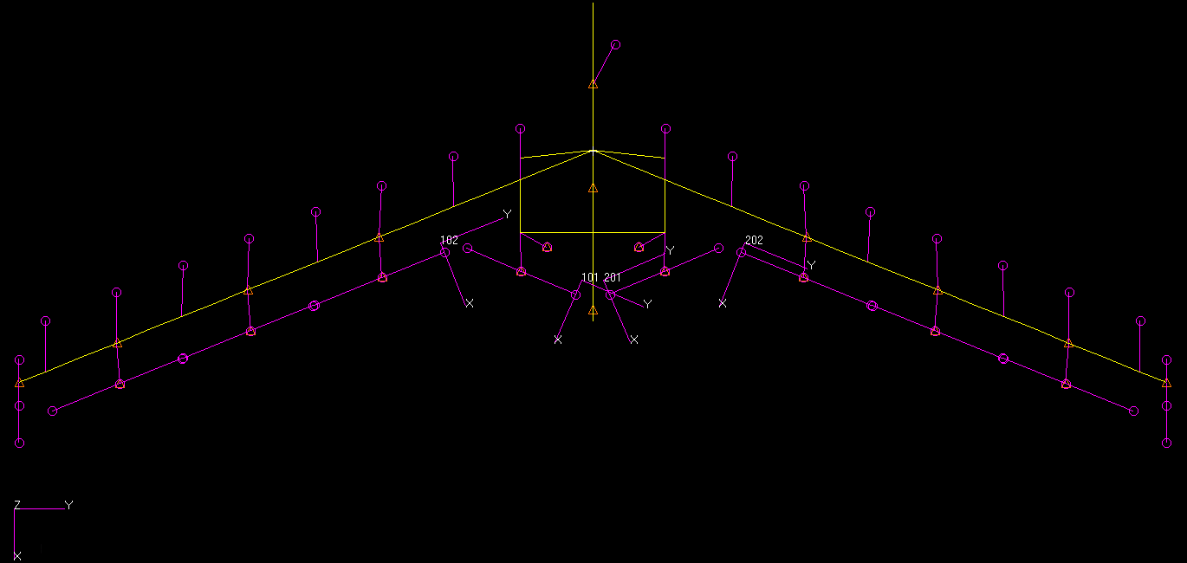
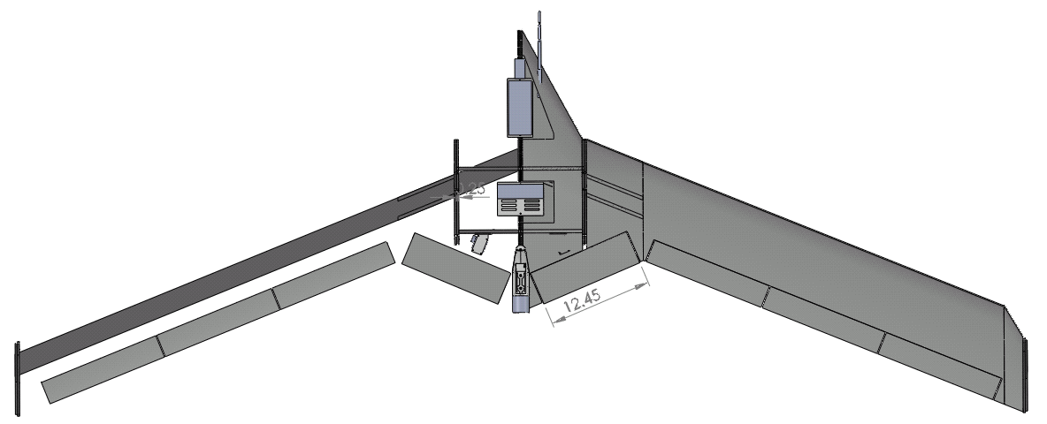
mAEWing1 FEM v1.0 and Mass estimates
mAEWing1
NASTRAN
Beam-rod FEM v1.0
Property | mAEWing1 | BFF
Total weight, lb | 12.022 | 11.99
C.G. location (From nose), inches | 24.998 | 23.29
Pitching moment of inertia, Iyy, lb-in^2 | 1126.22 | 1245.83
Rolling moment of inertia, Ixx, lb-in^2 | 9595.70 | 8529.45
CAD model of mAEWing1 provided by UMN

Slide 3
Main data
 | EI (lb-in^2) | E (psi) | Ixx(out-of-plane) (in^4) | Izz(in-plane) | GJ (lb-in^2) | G (psi)
Predicted Spar Properties | 3.3948E+04 (97.43 N-m^2) | 6.6601E+06 (45.92GPa) | 5.097E-3 ( 2.12E-9 m^4) | Assume 300 Ixx | 2.0603E+04 ( 59.13 N-m^2) | 1.2518E+06 (8.63 GPa)
 | J (in^4) | Cross sectional Area (in^2) | Density (lb/in^3)
 | 1.646E-2 (6.85E-9 m^4) | 2.7’’*0.45’’ | 0.05257 (1450kg/m^3)
 | Density, lb/in^3
XPS | 0.0015
Component | Actuators (Futaba S9254 ) | Flight computer | Batteries | Engine motor | Winglet | Servos
Weight | 0.126 lb | 0.513lb | 0.50 lb | 0.441 lb | 0.1102 lb with 2.7’’ offset to EA | 0.02205 lb
CG locations of these components are calculated in SolidWorks, they could not match with real data

Slide 4
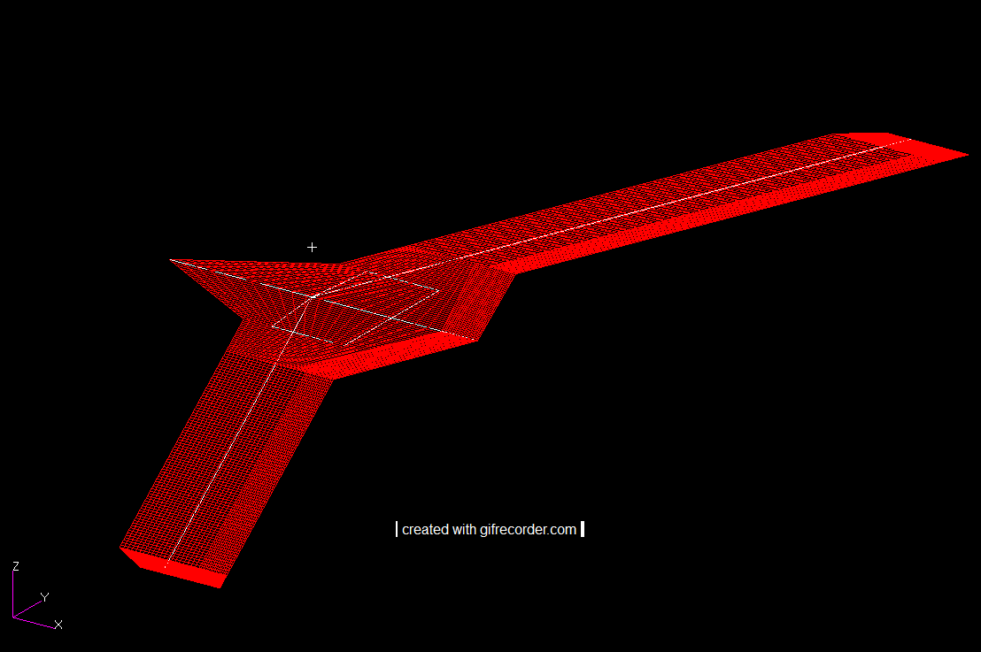
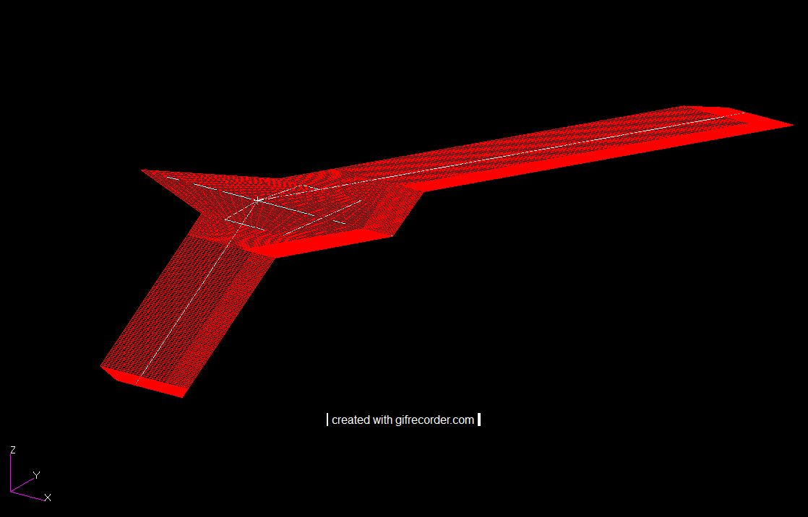
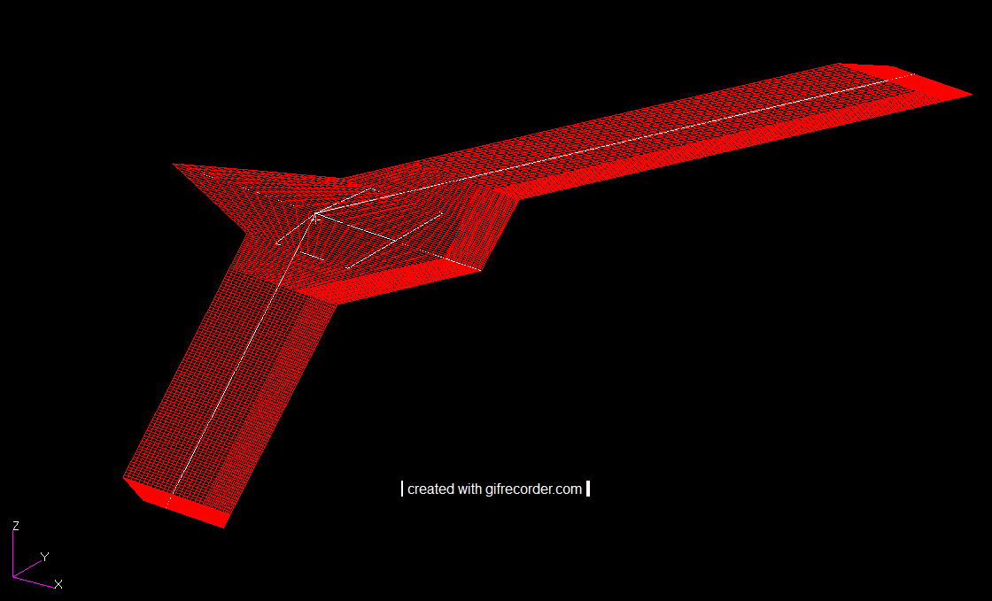
Rigid plunge mode
Rigid plunge mode
Rigid Roll mode
6 Rigid modes obtained from NASTRAN are orthogonal and normalized to system mass matrix
NASTRAN only spline rigid DOFs including plunge mode, roll mode and pitch mode to the aerodynamic panels
Rigid pitch mode

Slide 5
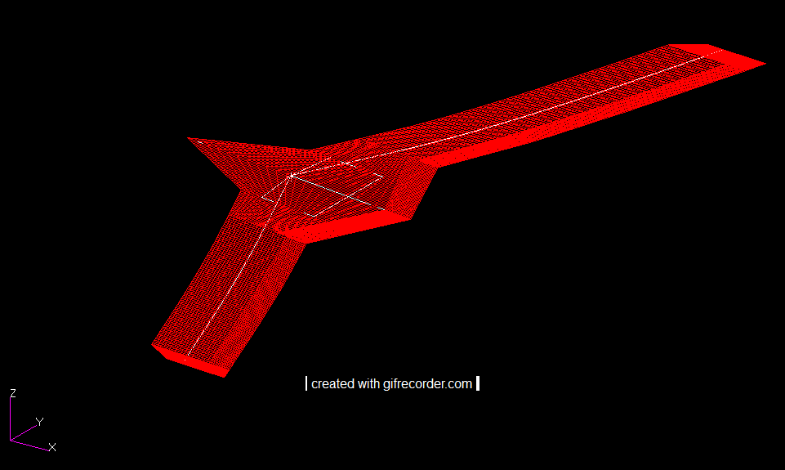
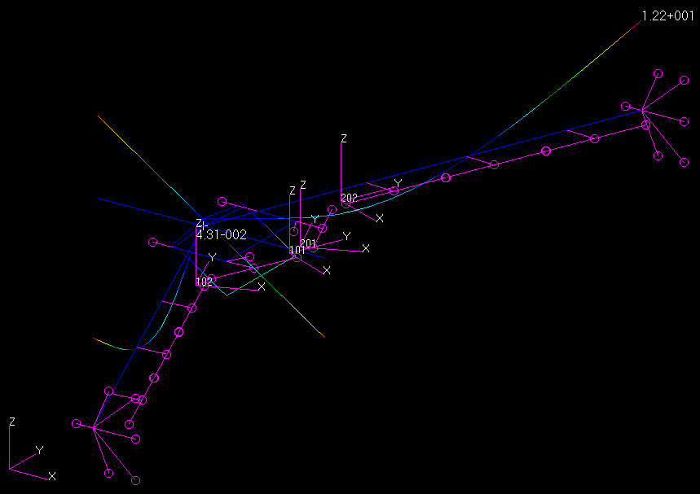
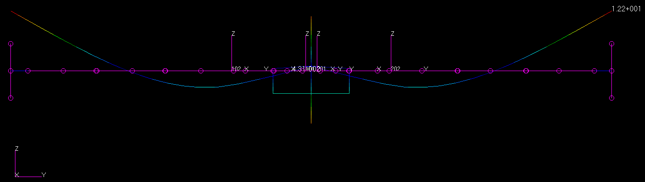
1st Sym Bending Mode
1st Symmetric Bending (SB)
5.492 Hz
(BFF: SB& 5.67 Hz)

Slide 6
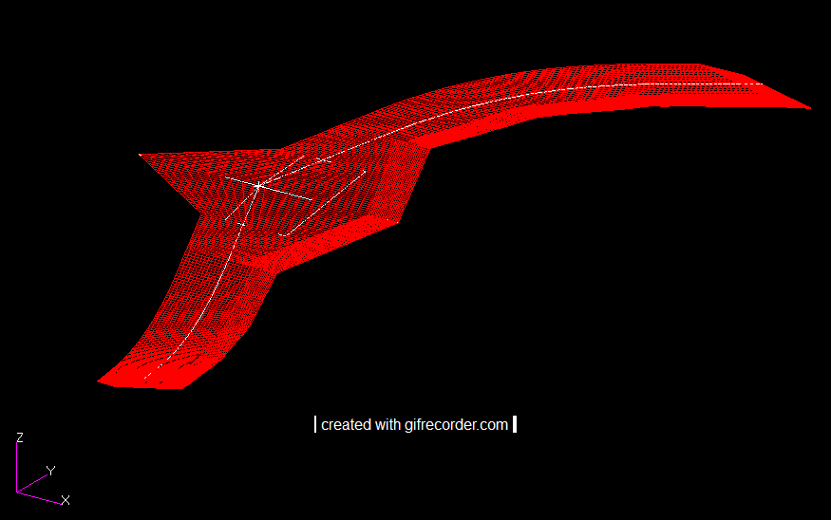
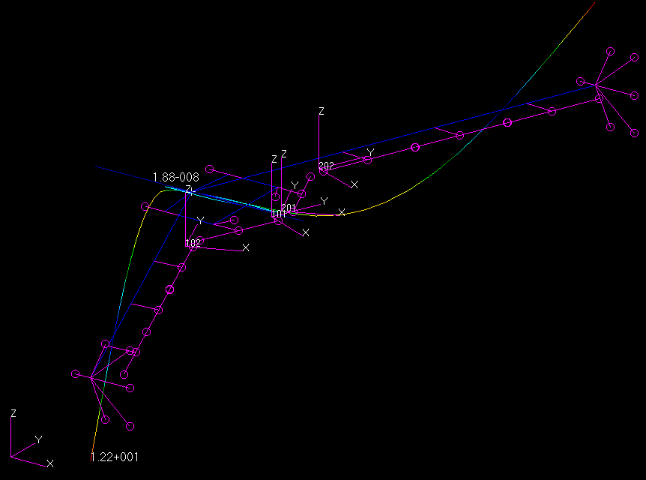
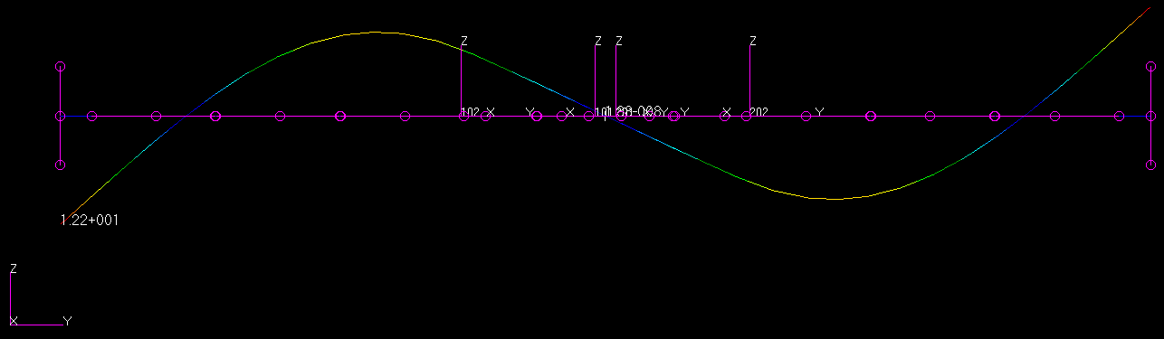
1ST AS Bending Mode
1st Anti-Symmetric Bending (ASB)
8.563Hz
(BFF: ASB& 8.37 Hz)

Slide 7
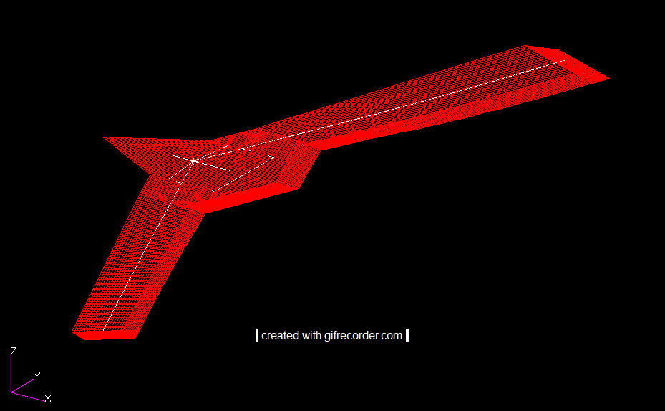
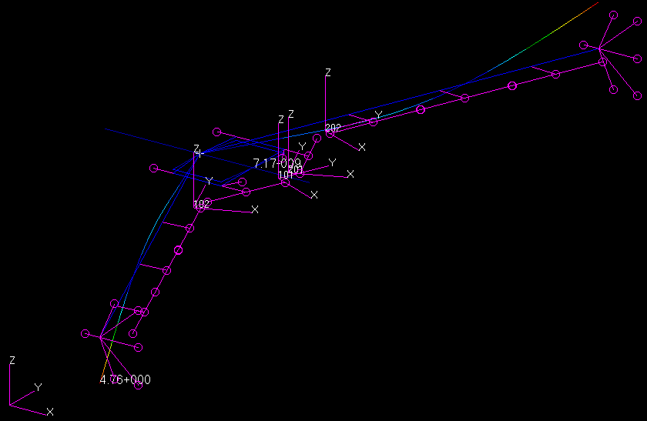
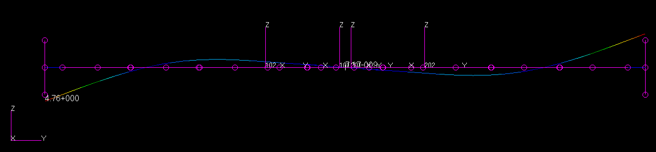
1ST AS Torsion Mode
1st Anti-Symmetric torsion (AST)
16.53 Hz
(BFF: ST& 18.44 Hz)

Slide 8
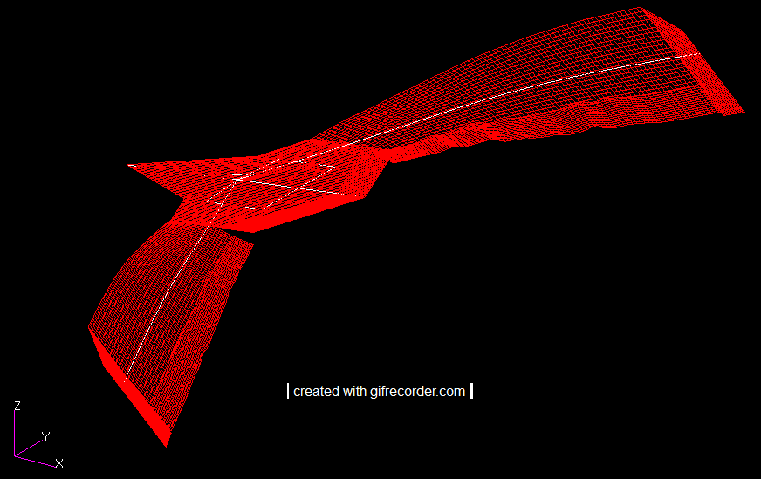
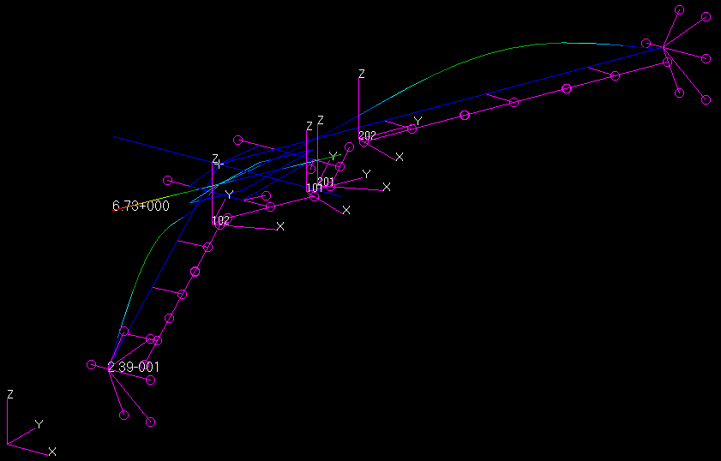
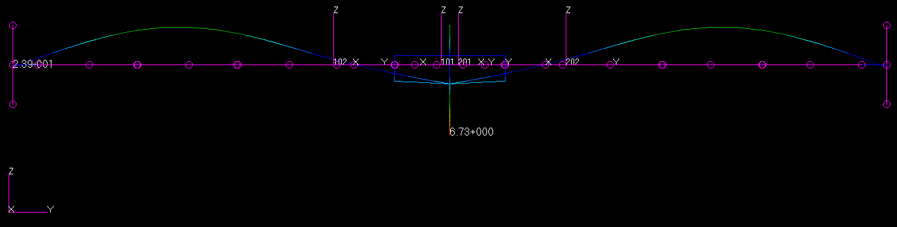
1st SM Torsion Mode
1st Symmetric Torsion (ST)
17.34 Hz
(BFF: AST & 19.82 Hz)

Slide 9
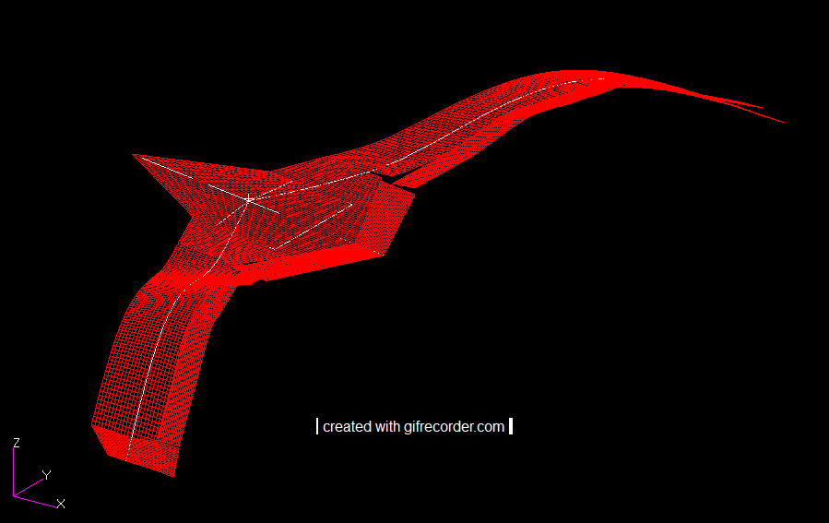
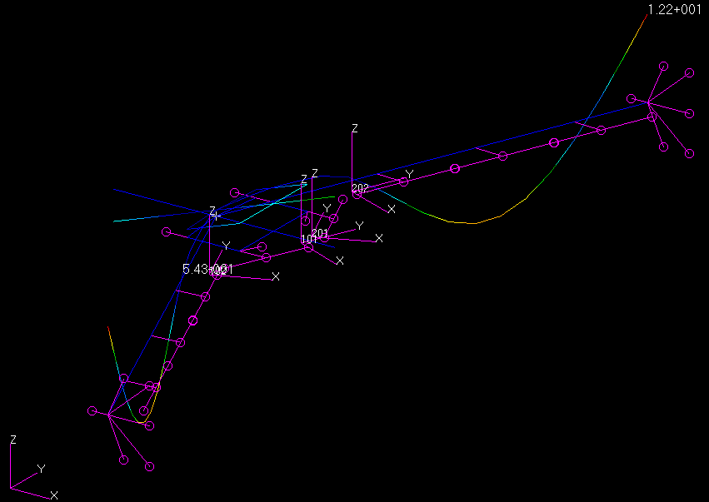
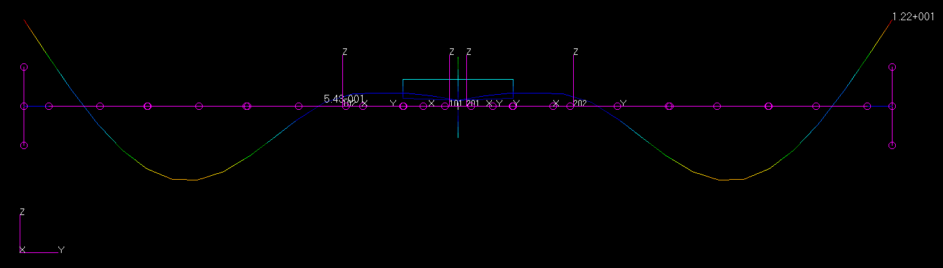
2nd SM Bending Mode
2nd Symmetric Bending (SB)
21.33 Hz
(BFF: SB& 23.17 Hz)

Slide 10
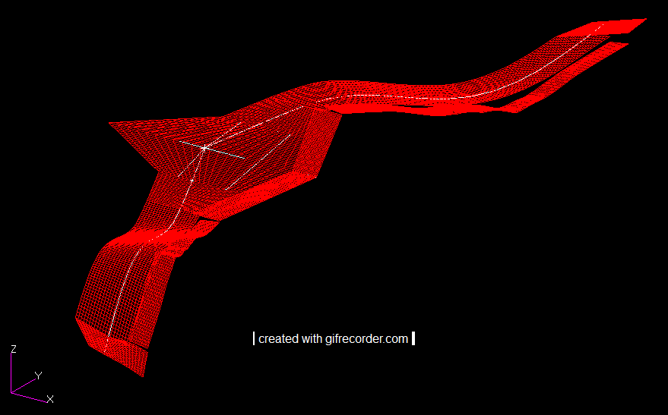
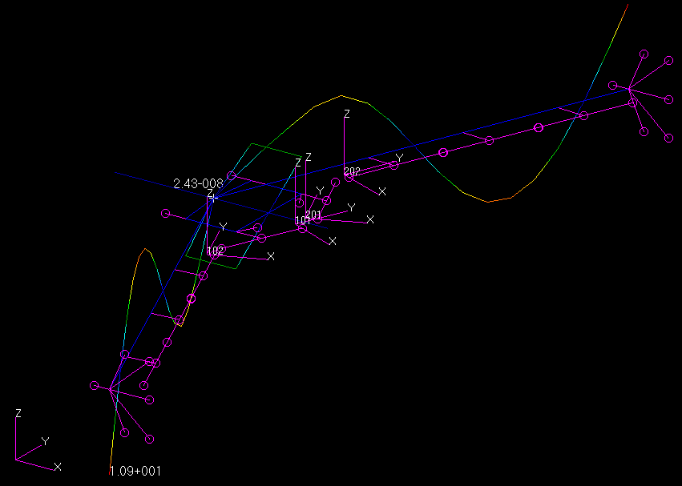
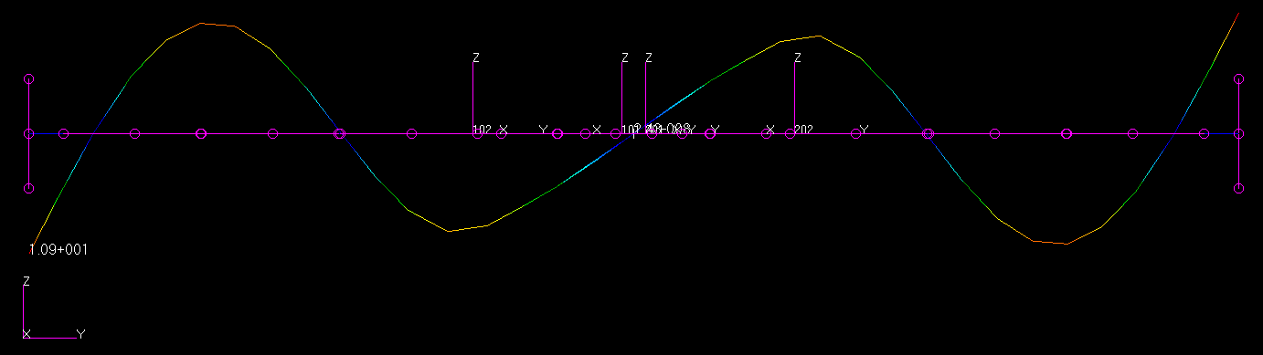
2nd ASM Bending Mode
2nd Anti-Symmetric Bending (ASB)
29.27 Hz
(BFF: ASB& 28.60 Hz)

Slide 11
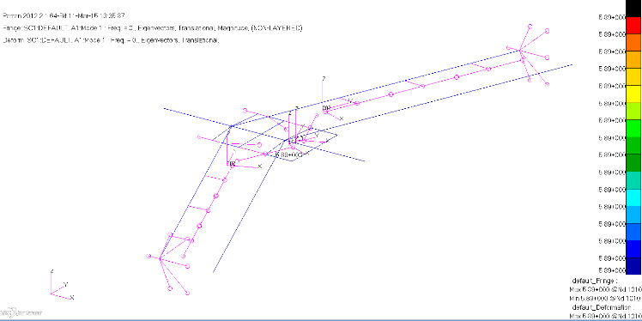
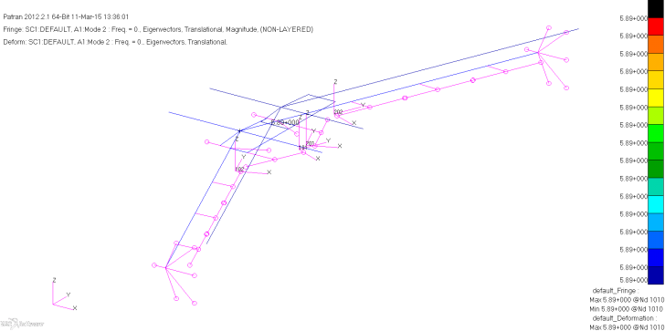
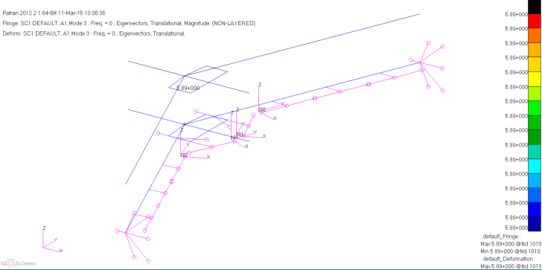
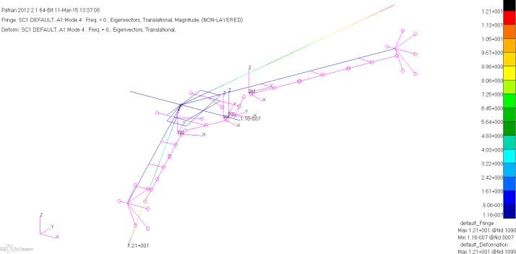

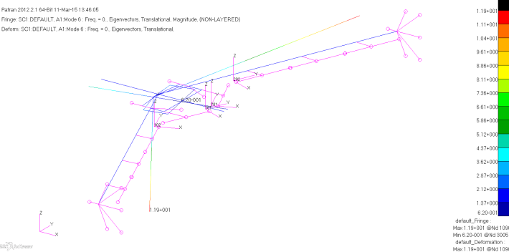
6 Rigid modes
Mode 1
Rigid translational motion along x-axis
Mode 2
Rigid translational motion along y-axis
Mode 3
Plunge mode
Mode 4
Roll
Mode 5
Pitch
Mode 6
Yaw

Slide 12
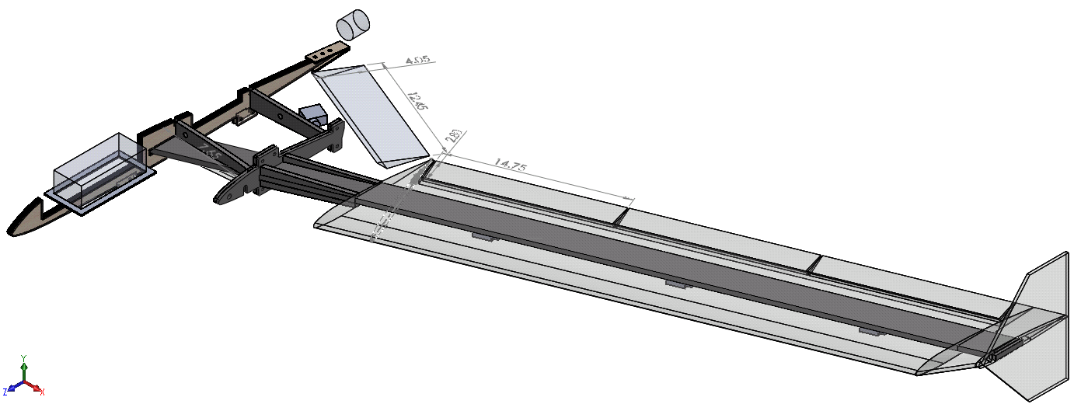
Uncertainties
Assumed Stiffened members properties
Uncertainties in current FEM:
Material and beam/rod properties for stiffened members
Equivalent values for material properties and beam properties based on predicted data(carbon fiber sandwiches for all panels )
Point mass distributions and their locations in fuselage
GVT data needed for model update to reflect the real mAEWing1 modeling

Slide 13
Summary
Mimic CAD model of mAEWing1 for FEM, current FEM version represents the accurate locations of components except those in the fuselage.
mAEWing FEM v1.0 subjected to change based on mode updating
Deliver to CMSoft for CSD/CFD flutter analysis?
Comments and Questions?

